Slide 1
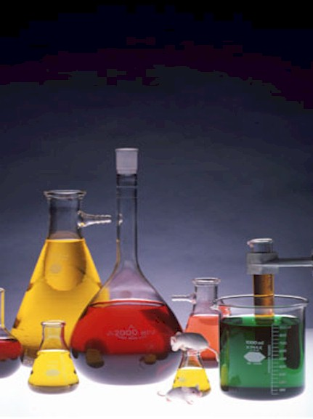
Chemical Spill Response, Personal Protective Equipment (PPE), and Fire Safety
Wesley Kolar, UGA Hazmat Response Coordinator – wkolar@esd.uga.edu

Slide 2
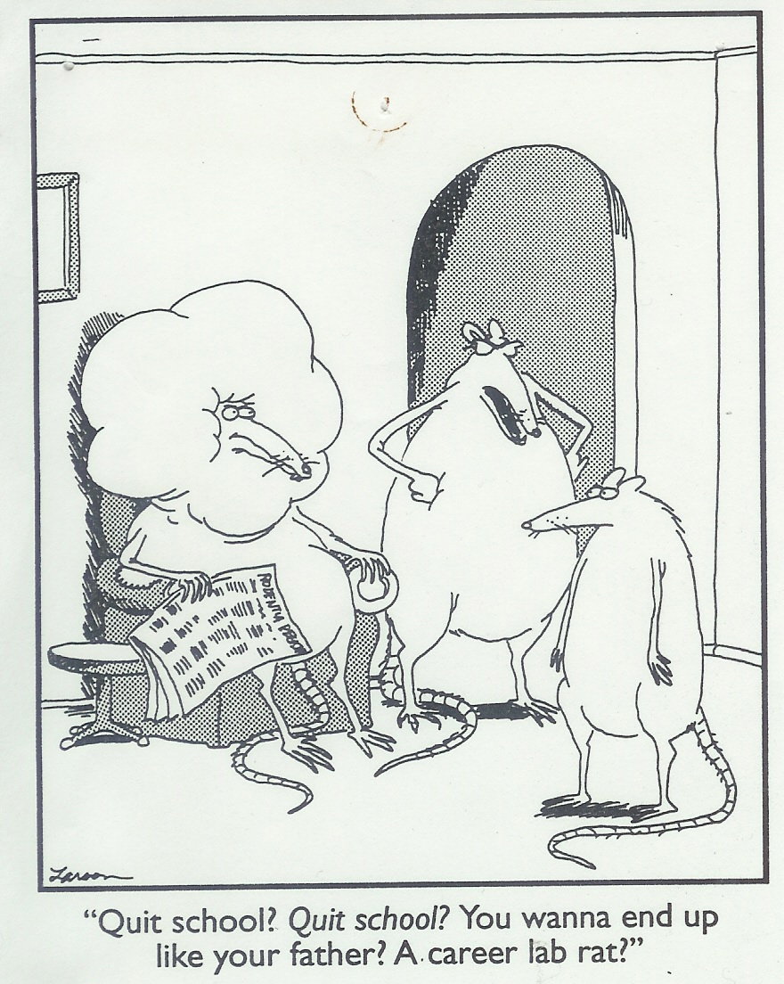
The most important thing that you can do in laboratory is to protect yourself and others. Do not attempt to perform a spill cleanup if you are not properly equipped and prepared.

Slide 3
Be Prepared
Keep Material Data Safety Sheets
(MSDS) outside of laboratory,
2) Keep spill response materials in
the laboratory,
3) Know the hazards of all
materials that you work with,
4) Know the location of safety
showers and eye washes,
5) Develop and know spill response
procedures ahead of time.

Slide 4
When a Spill Occurs
Isolate the area of the spill,
Notify others that a spill has
occurred,
If possible, turn on fume hood,
If possible, turn off ignition
sources,
Evacuate the area as needed.
Do not work alone!!

Slide 5

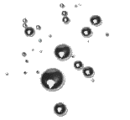
To insure that mercury particles do not get scattered across the laboratory, elemental mercury spills require special attention. Small mercury spills kits are relatively inexpensive and easy to use. Larger spill cleanups may require specialized equipment to perform (mercury vacuum etc.).

Slide 7
Material Safety Data Sheets
Chemical identity and components
Manufacturer - address/phone number
Physical & chemical characteristics
Fire & explosion hazard information
Personal protective equipment
Chemical exposure information
Spill information
Disposal information

Slide 8
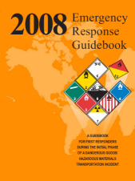
Use more than one source to identify chemical hazards. The ERG is a good source of basic information.

Slide 9
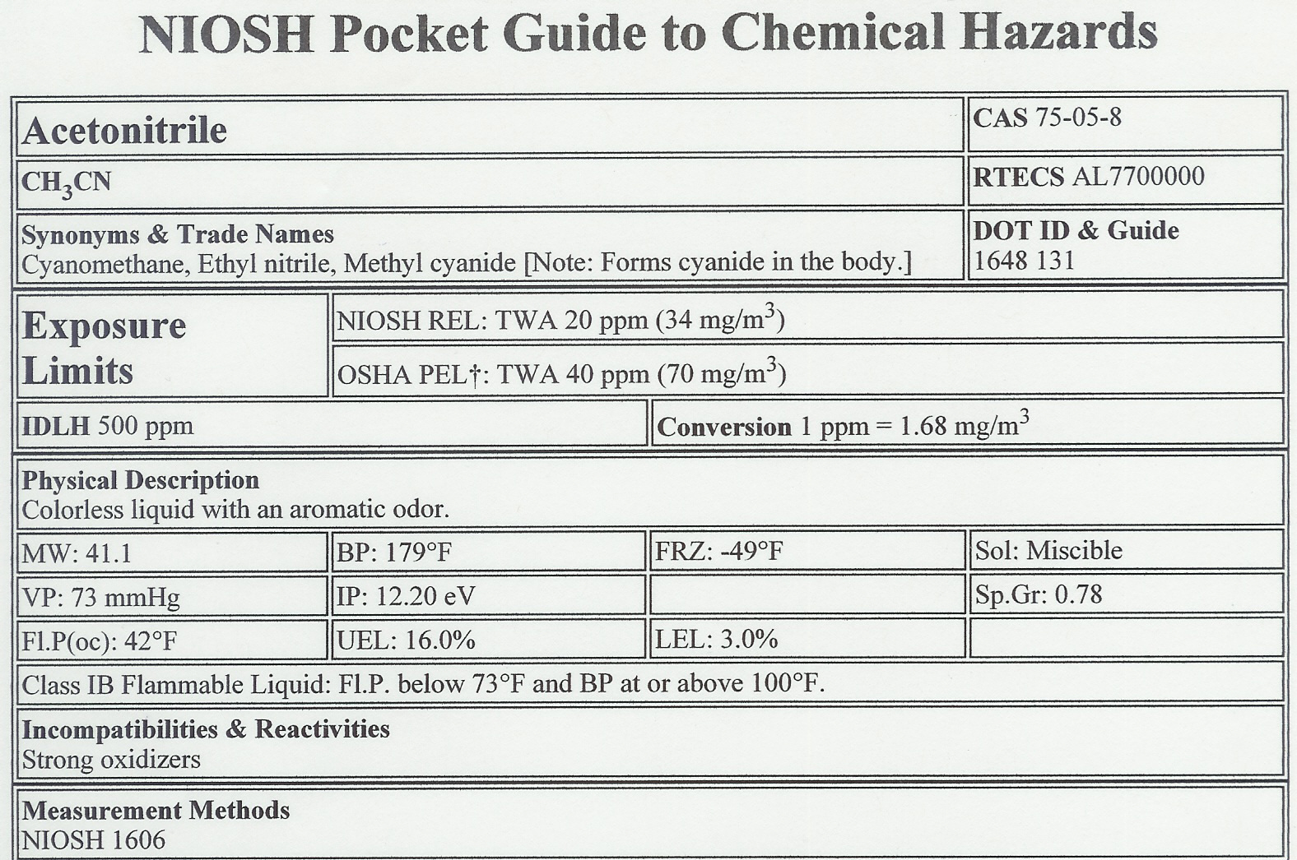
Excellent Source of Respiratory Protection Information

Slide 10
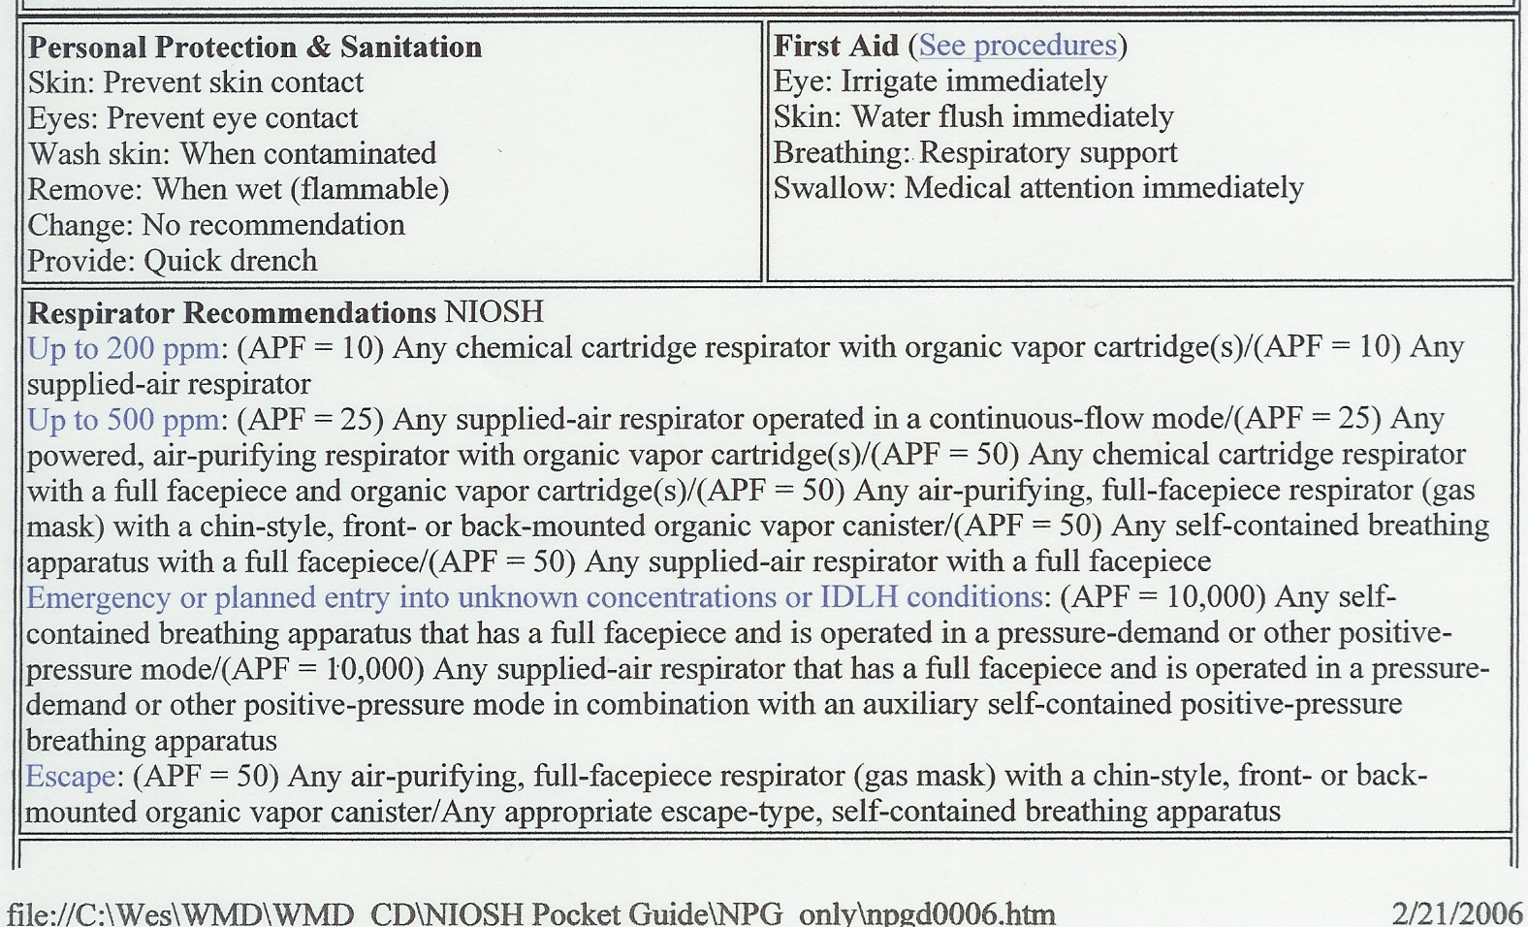
Note the presence of specific respirator recommendations.

Slide 11
Additional Sources of Information
Chemical manufacturers,
Chemical labels,
Chem-trek – (800) 424 – 9300,
Poison Control Center
(800) 222-1222,
The Internet.

Slide 12
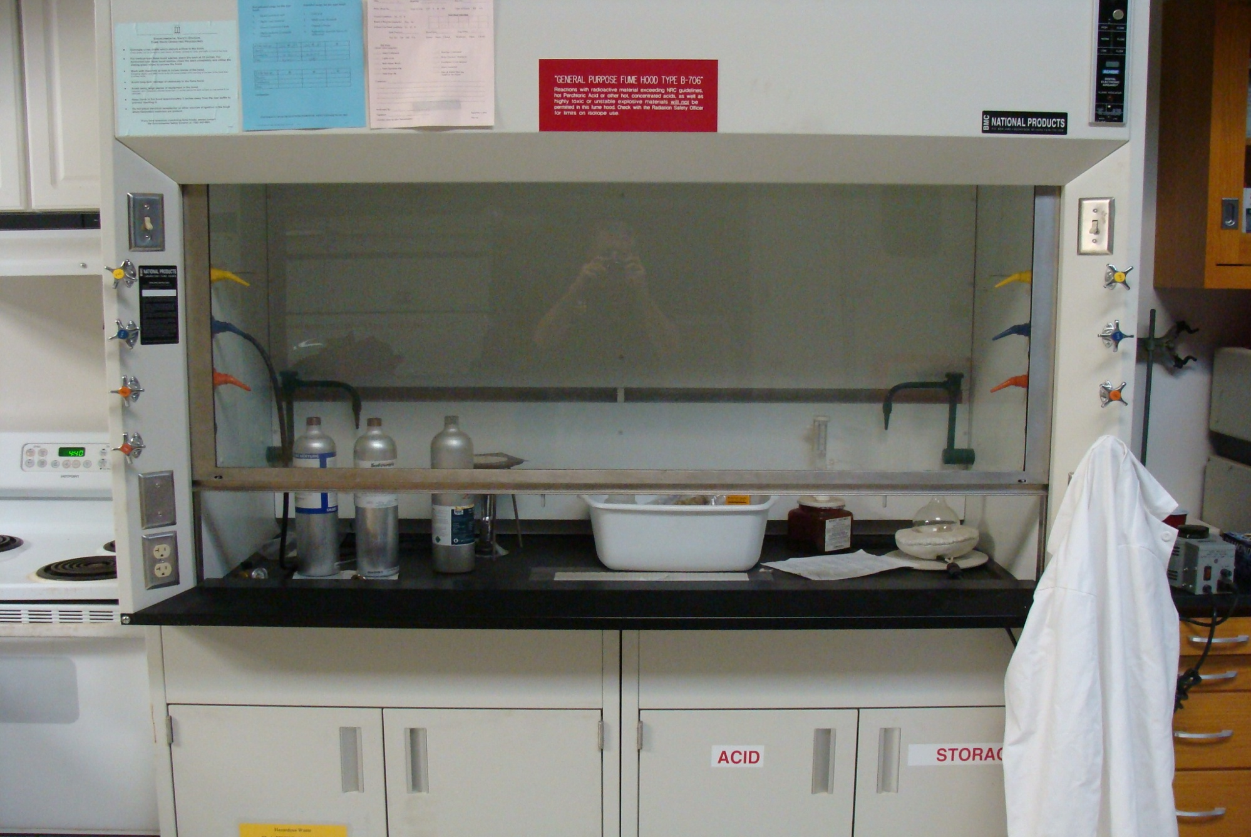
Chemical fume hoods can be employed to help remove hazardous vapors from a lab.

Slide 13
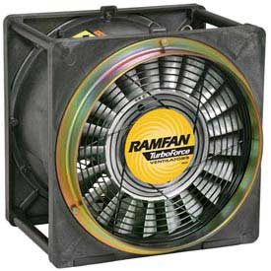
Intrinsically safe fans with ducting can be use to help dissipate hazardous and flammable vapors.

Slide 14
Most laboratory spills are relatively small and well confined. Cleanup can usually be accomplished with minimal PPE and equipment.

Slide 15
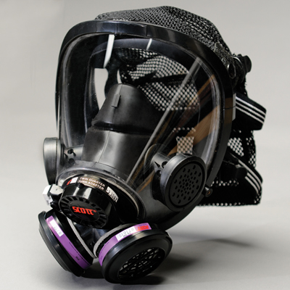
Respiratory protection should be worn when vapor levels are unknown, or are above permissible exposure limits (PEL).
Air Purifying Respirator

Slide 16
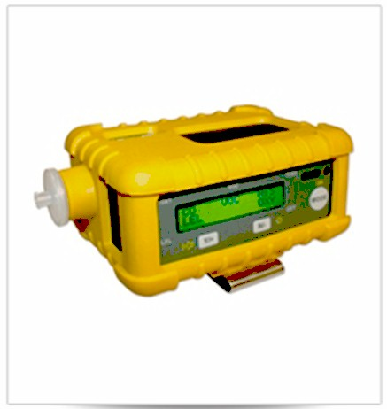
A VOC meter can be used to determine the level of hazardous vapors that are present in the laboratory.

Slide 17
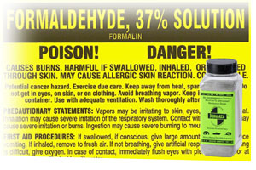
Formaldehyde spills typically produce dangerous levels of vapor. Respiratory protection must be worn when cleaning up formaldehyde spills. Use specialized cleanup materials.

Slide 18
Tight fitting respirators require fit testing before use. Loose fitting hoods employed with PAPRs do not require user fit testing.

Slide 19
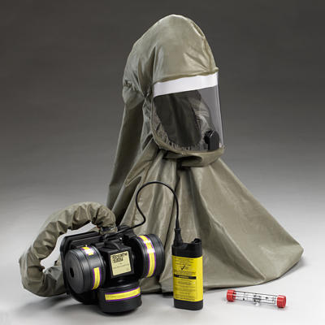
Powered air purifying respirators (PAPRs) are more protective than APRs, and do not require fit testing when used with loose fitting hoods.

Slide 20
APRs and PAPRs do not provide oxygen and must not be used in oxygen deficient environments such as those commonly found in confined spaces.

Slide 21
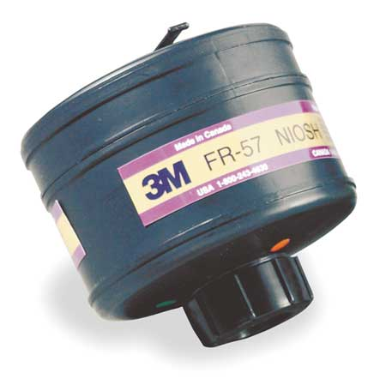
WMD cartridges have HEPA filters and protect the user from organic vapors, acid gases, formaldehyde, and several common WMD agents.
In order to obtain the maximum useful lifetime, chemical cartridges should remain capped when not in use.

Slide 22
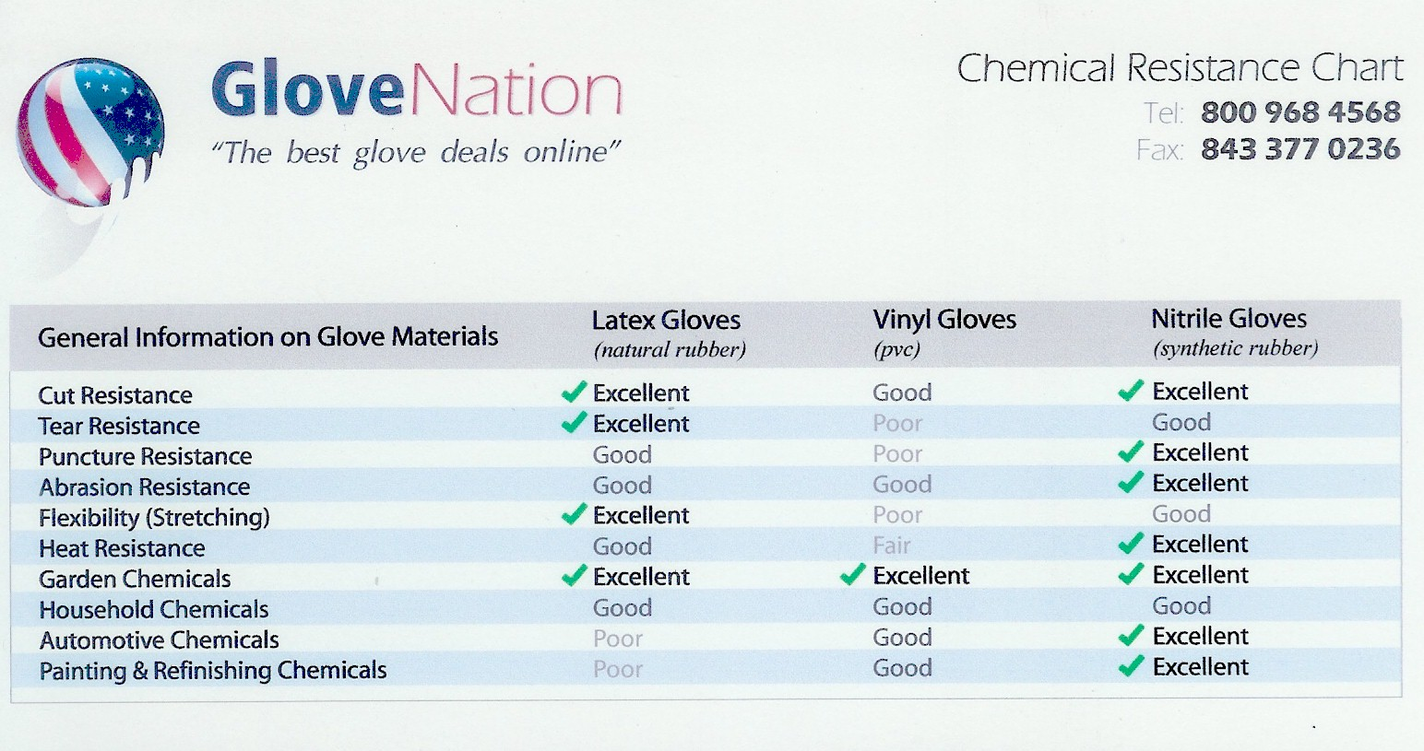
http://www.glovenation.com/

Slide 23
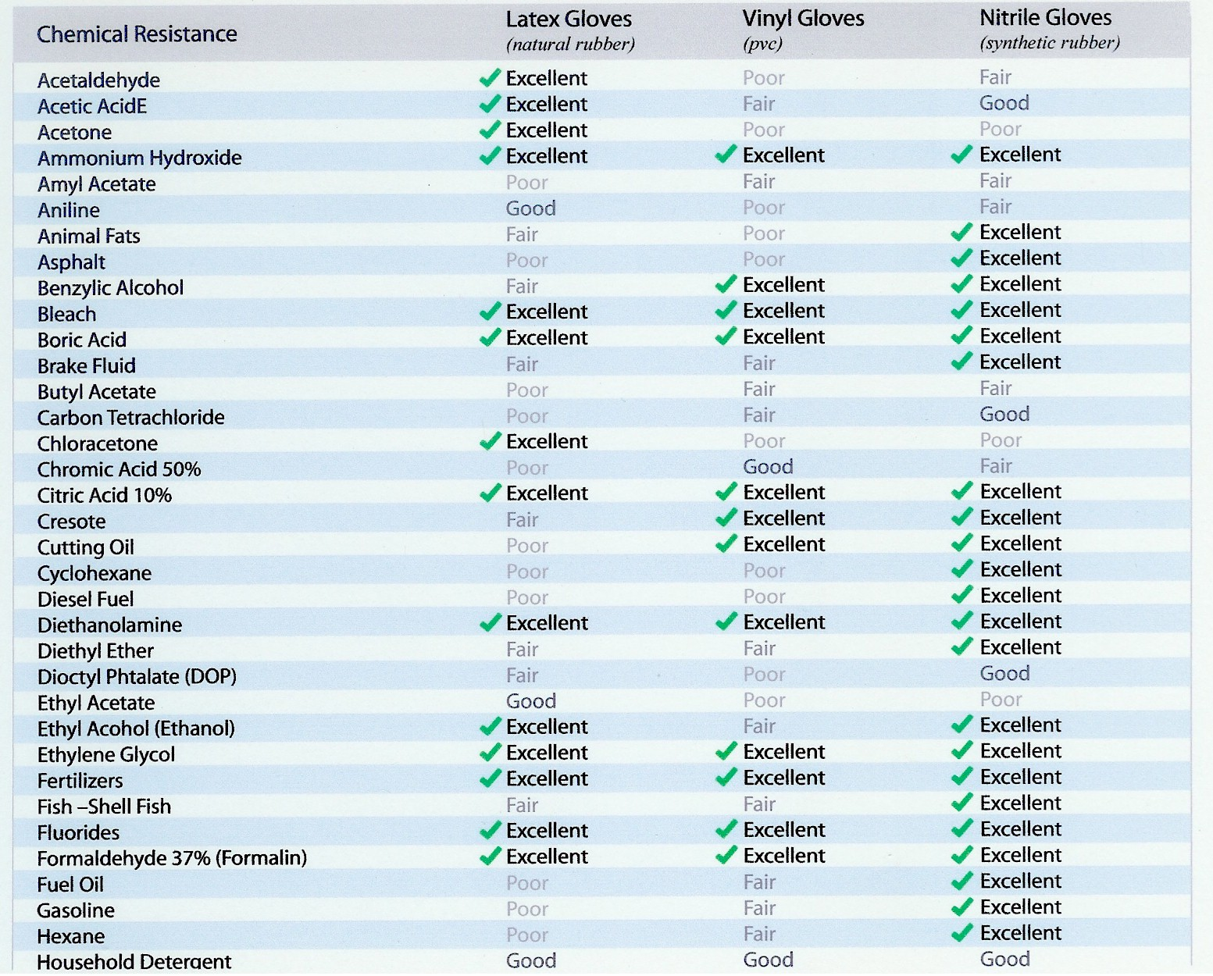

Slide 24
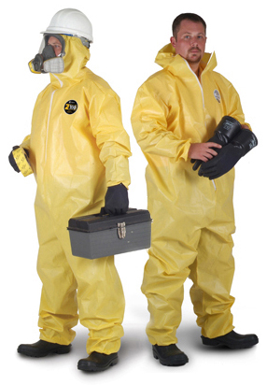
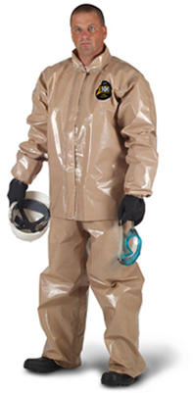
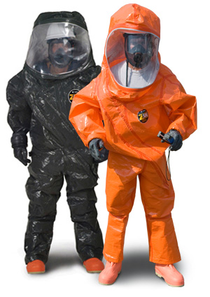
Chemically resistant suits are available for light, medium and heavy duty. Medium and heavy duty suits are more expensive and cumbersome to use. Light duty suits are fine for most laboratory spills.

Slide 25
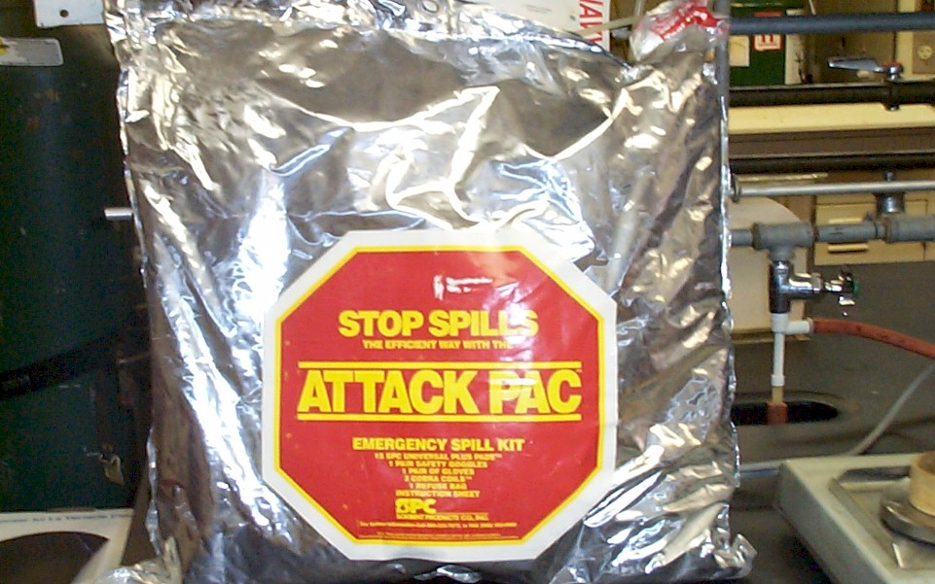
Generic spills kits are relatively expensive, and are typically only good for a single use.

Slide 26
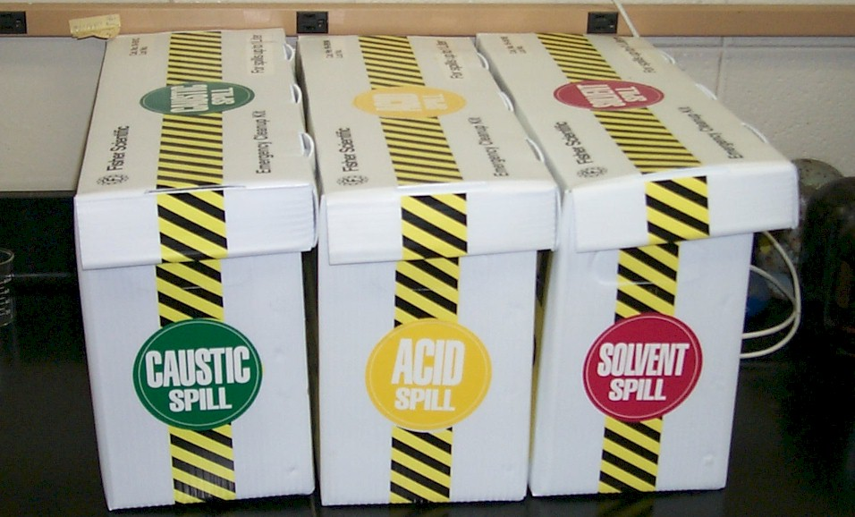
Some spill kits also contain neutralizers and absorbents specifically designed for solvents.

Slide 27
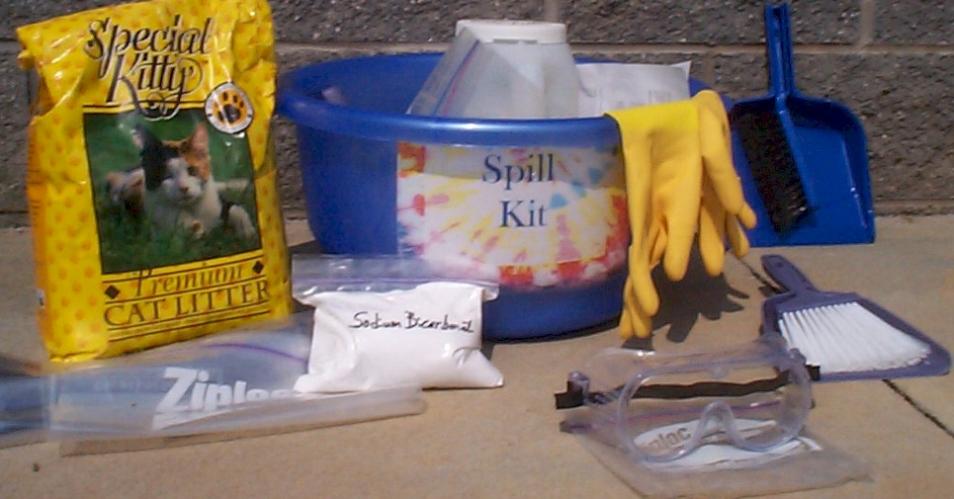
Homemade spill kits are much less expensive, and can be tailored to fit the needs of the laboratory.

Slide 28
20 March 2002 | In the early morning hours of Jan. 11, fire broke out in a UC Santa Cruz science building. It took nearly five hours, 60 firefighters and 5,000 gallons of water to quell the blaze. When the smoke cleared, two labs had been completely destroyed — along with years of genetic research — and the building suffered major damage. Initial estimates put the damage at $5 million. Though the cause is still unknown, the fire appears to have started on a lab bench. According to UC Santa Cruz Fire Chief Charles Hernandez, possible culprits include a hot plate that was left on or malfunctioned or flammable liquid that was discarded improperly.

Slide 29
Texas Tech Laboratory Fire – “One of Many Such Laboratory Incidents”
On January 15, 2001, a fire occurred in a Chemistry Building laboratory. A 4-liter bottle of flammable liquid broke inside a fume hood, emptying its contents into the hood and onto the floor. Several hot plates were located inside the hood and ignited the flammable liquid. A researcher was unable to extinguish the fire with two portable fire extinguishers and quickly exited the laboratory. 9-911 was called.
Other bottles of flammable materials soon broke, providing more fuel and allowing the fire to intensify. Soon after, a small explosion occurred when flammable materials stored in the cabinet underneath the hood became involved in the fire. The Lubbock Fire Department soon arrived and extinguished the fire.

Slide 30
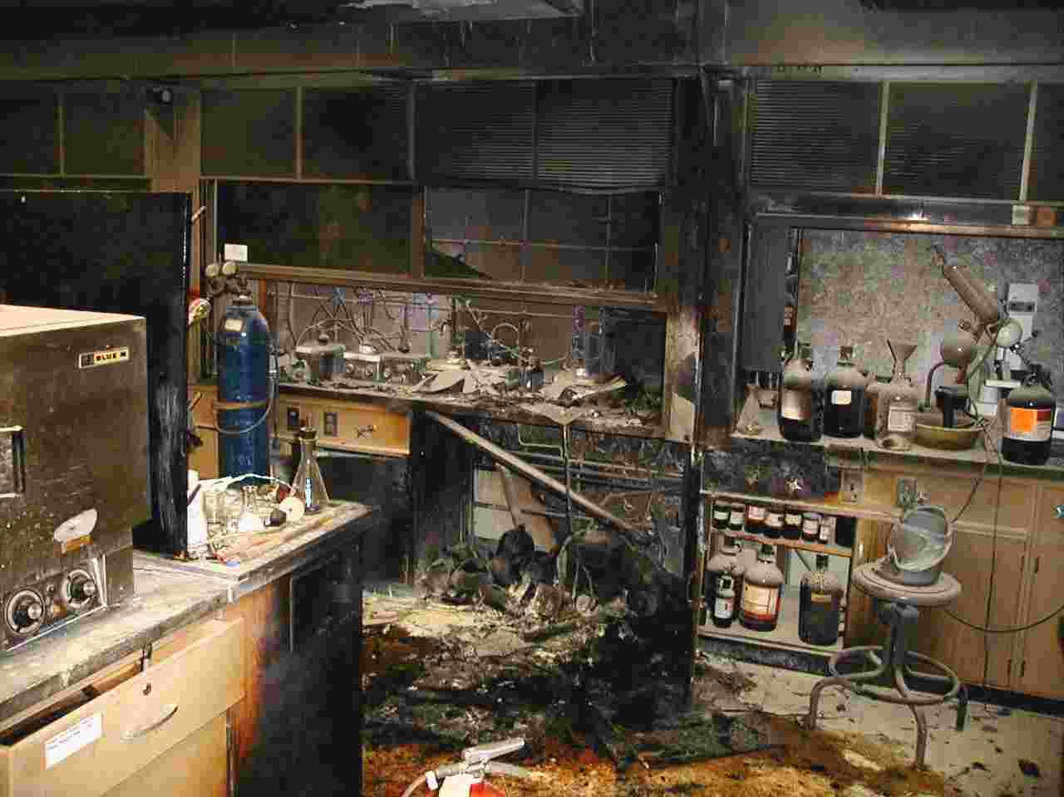

Slide 31
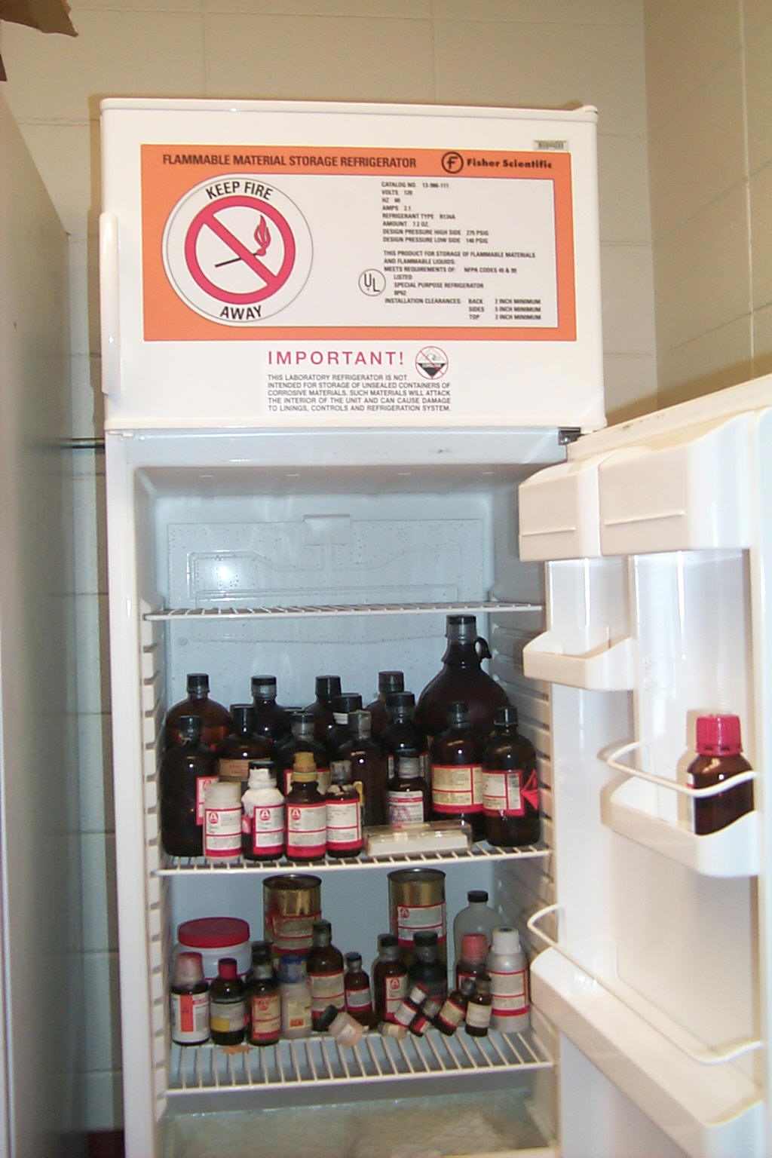
Flammable liquids must never be stored in household refrigerators. Intrinsically safe refrigerators have no spark sources that can ignite vapors.

Slide 32

UGA Wilson Pharmacy Fire
September 30th 10:00 PM – 100 mls of a flammable substance is spilled on the floor of lab. Most of the material is cleaned up, some seeps under refrigerator. October 1st 7:00 AM – Lab smoke detectors sense fire and automatically send warning to UGA Police. Police immediately notify ACC Fire Department.
7:30 AM – Fire extinguished by ACC FES, UGA spill response team is notified.

Slide 33
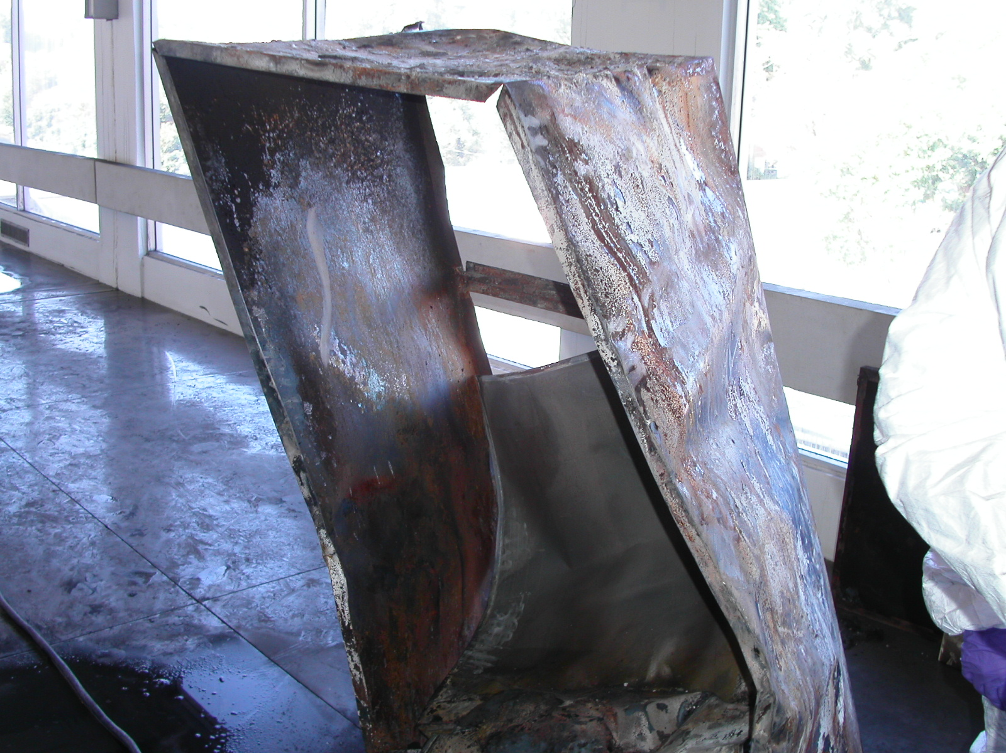

Slide 34
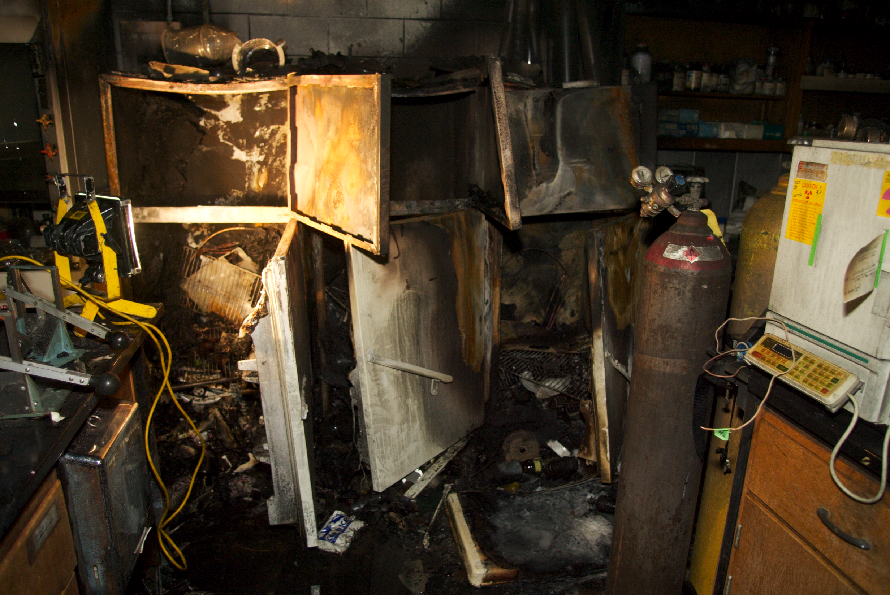

Slide 35
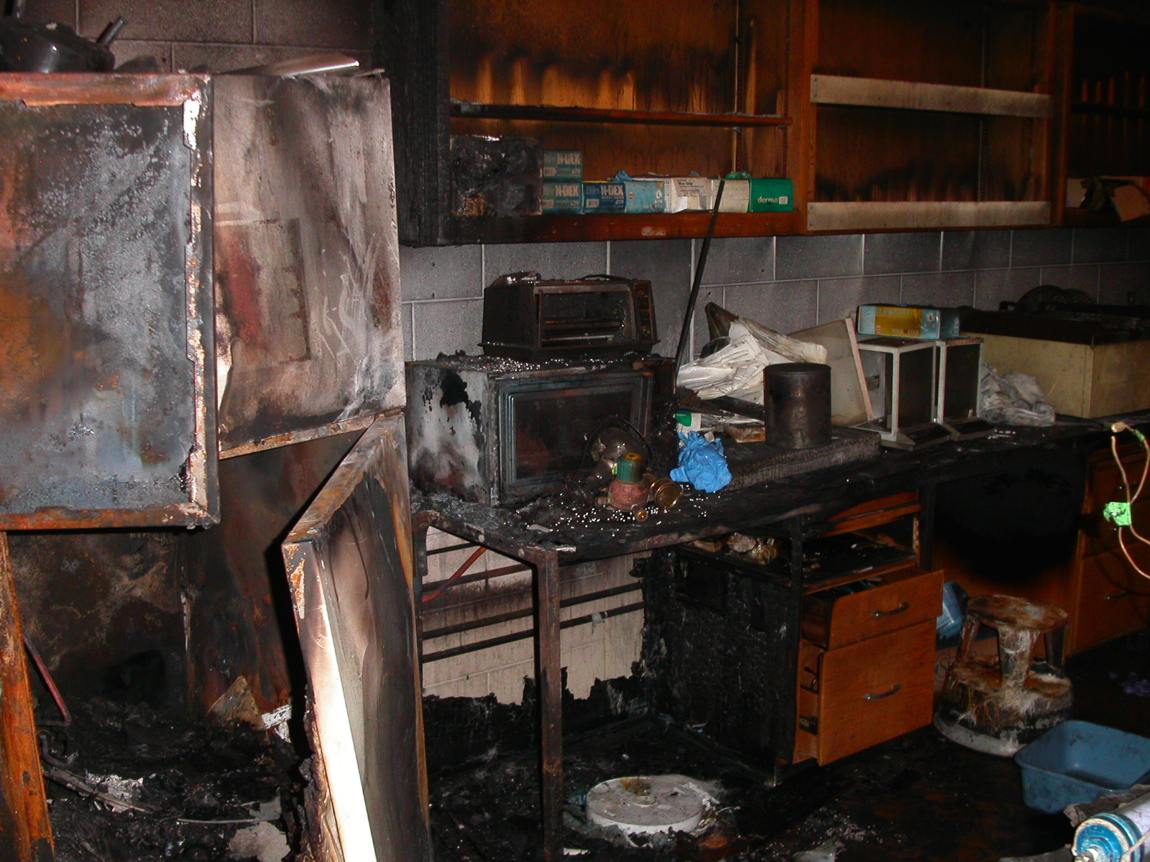

Slide 36
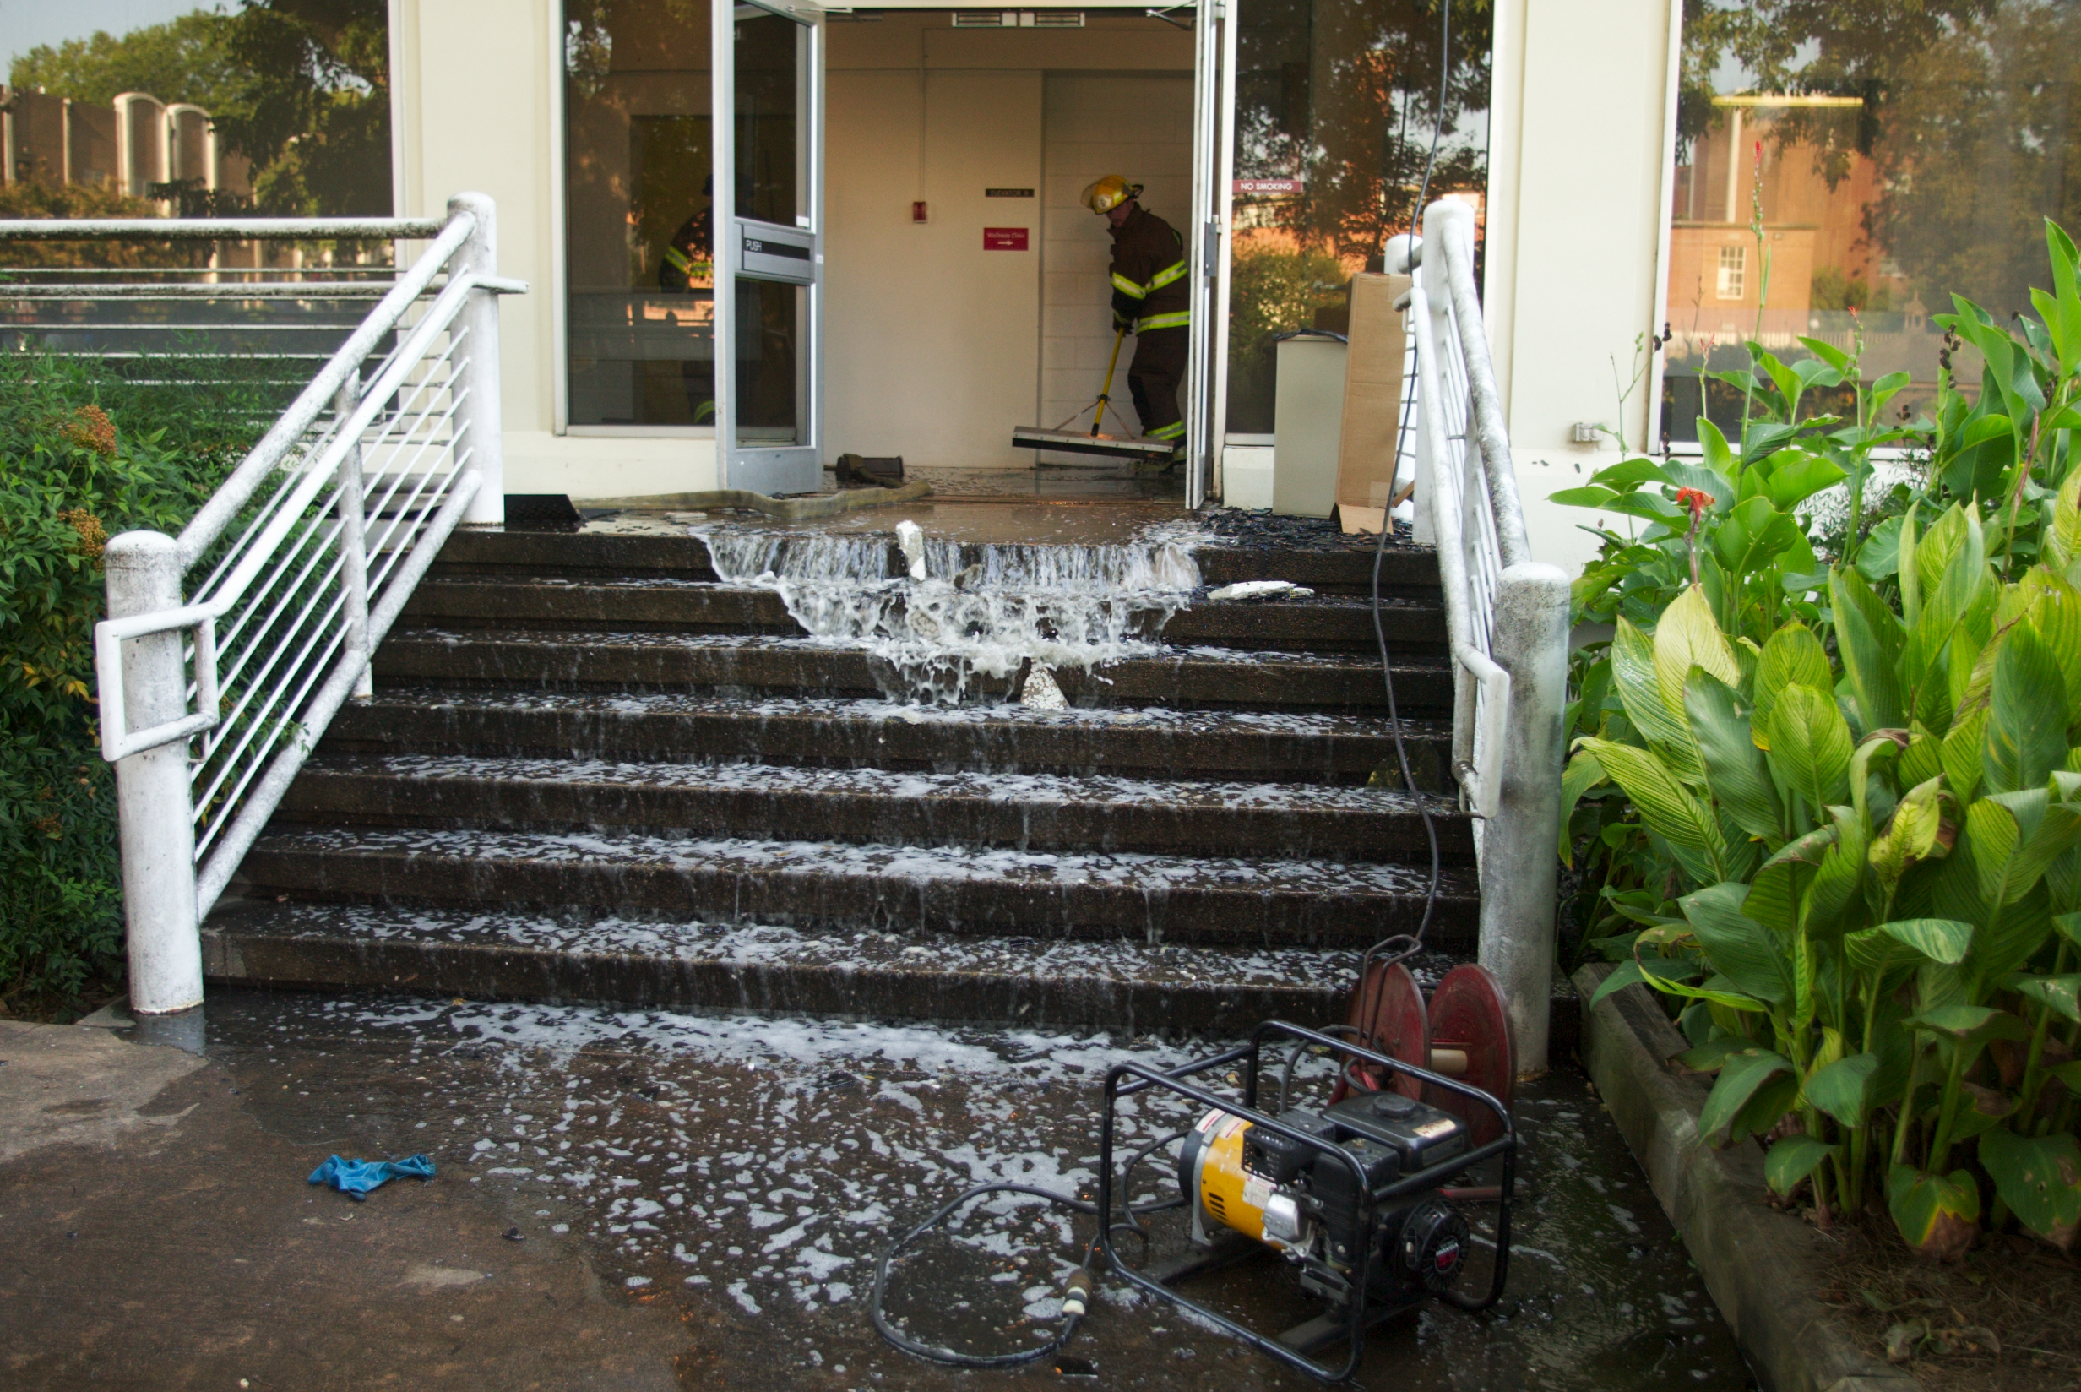

Slide 37
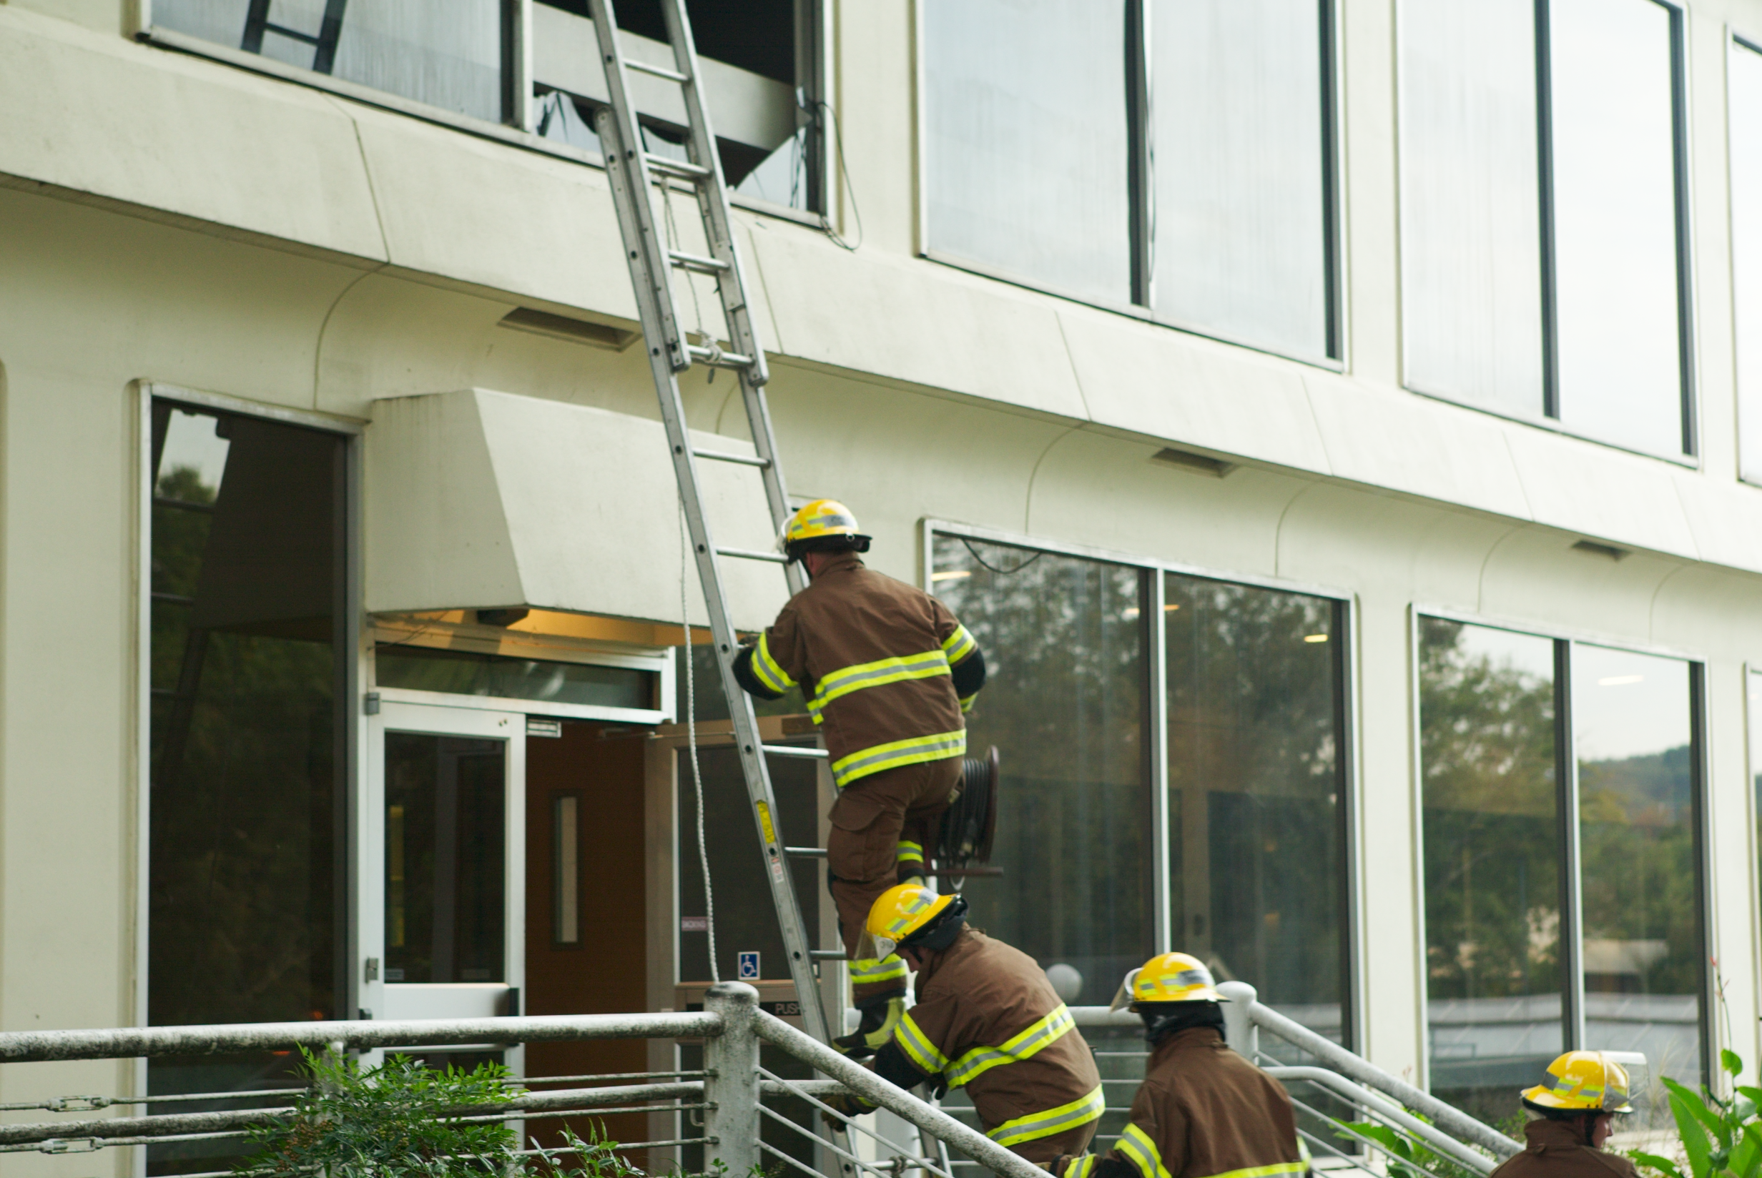

Slide 38
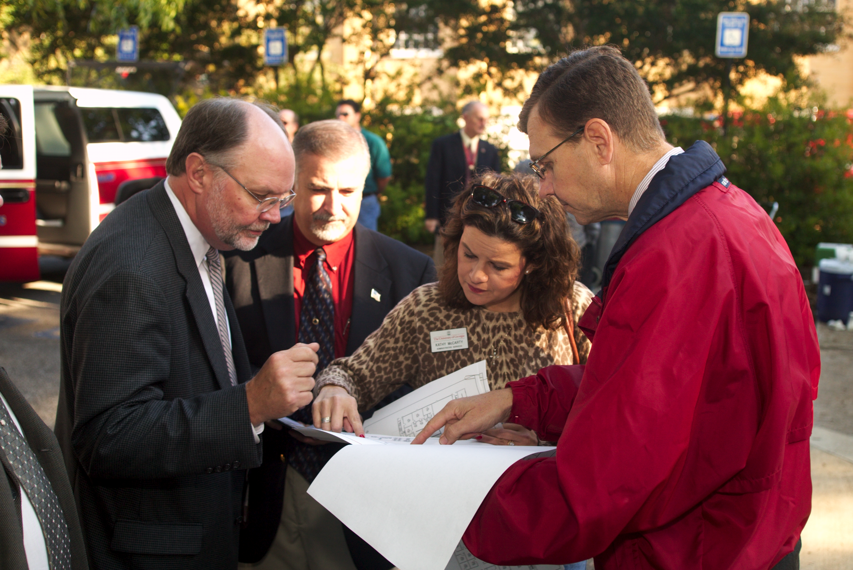

Slide 39
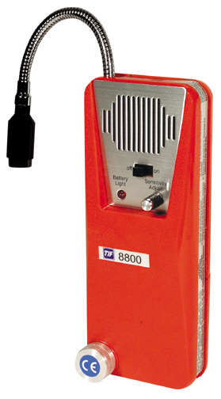
Inexpensive volatile organic compound (VOC) meters can be used to test for the presence of natural gas, and other flammable vapors. Detection limits are typically in the low part-per-million (ppm) range.

Slide 40
FLAMMABLE LIQUIDS
Explosive limit
of gasoline
LEL: min. % of vapor in
air which can explode
upon ignition
UEL: max. % of vapor in
air which can explode
upon ignition

Slide 41
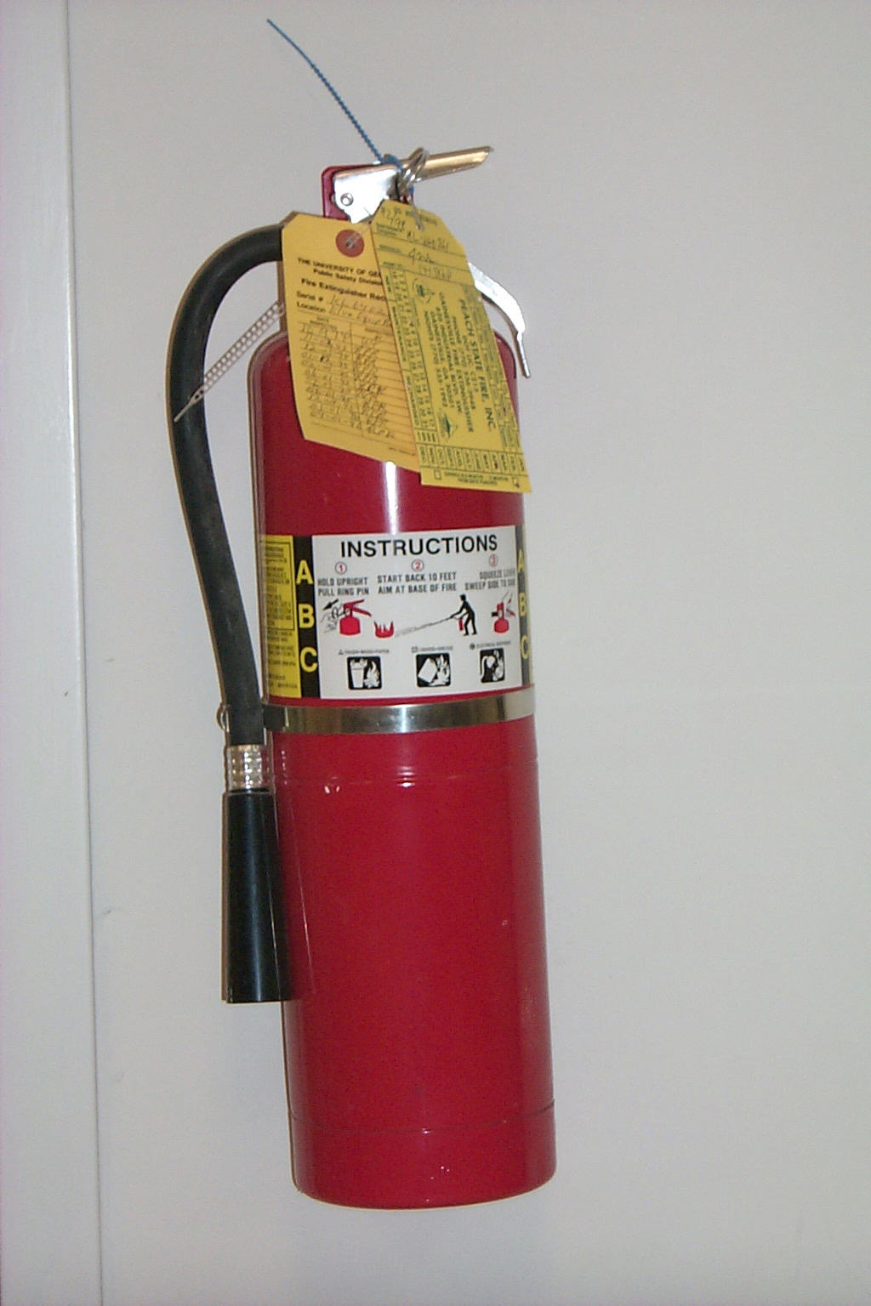
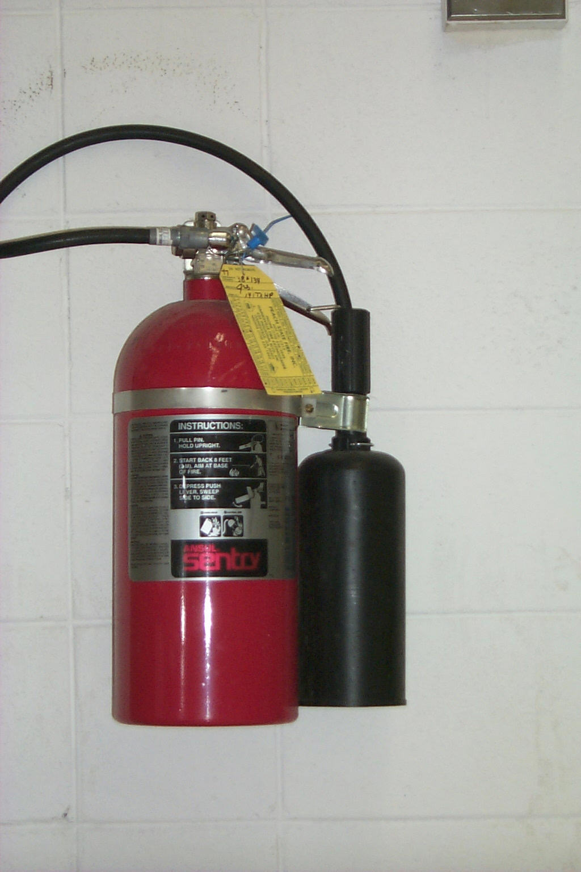
ABC extinguishers can be used on all types of fires.
Type B extinguishers must not be used for electrical fires.

Slide 42
Fire Safety Tips
Keep flammables in flammable liquid cabinets
Keep only what is needed out in the laboratory
Never leave hotplates and Bunsen burners unattended
Do not work alone in lab
Keep corridors unobstructed
Know how to use the fire extinguisher - training
Only fight small fires, and then only if you are able to
put them out within 2- - 30 seconds.
If unsure, pull the fire alarm, close the laboratory door,
and evacuate the building.

